Slide 1
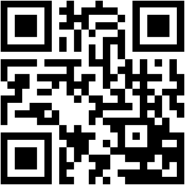
New Technology Working Group
Members
Fiona MAINI – Chairman
Alan Yeomans – Co-chairman
Thierry LEPOUTRE
Sofoklis KYRIAZAKOS
Vassiliki MANI
Yoanni MATSAKIS
Eva HANZLOVA
New Technology Working Group
EUCROF Secretariat, p/a LB Finance, Tappersweg 12T
2031 ET, Haarlem, The Netherlands
www.eucrof.eu | info@eucrof.eu
(Image courtesy of Viedoc Technologies, Sweden)

Slide 2
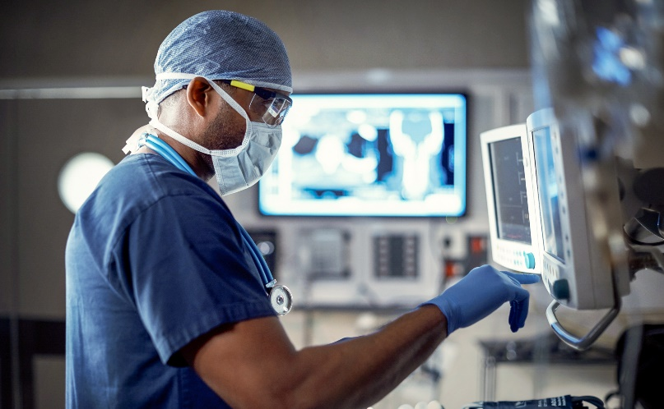
Mission
The group evaluates new technologies (both current and coming) and evaluates how these can impact and provide benefits to the clinical trial environment.
Keep EUCROF Members informed on directions in New Technology
Technology survey: to what extent technology can improve clinical trials
Position EUCROF as an expert / key stakeholder for the EU regulatory bodies
Highlights
EUCROF conferences
White papers distributed through the EUCROF website
Webinars
Webinars on hot subjects
Social media
The EUCROF LinkedIn group is used for the dissemination of information
(Image courtesy of Viedoc Technologies, Sweden)
If you are interested in becoming a member of this working group, please contact:
EUCROF Secretariat - info@eucrof.eu
or
Fiona Maini – fmaini@mdsol.com Chairperson of the Working Group
or
Alan Yeomans – Alan.Yeomans@viedoc.com
Co-chairman of the Working Group
We are looking for members who are interested in promoting and sharing expertise and developments, aimed at determining and setting overall strategic direction for CROs related to new technology, and liaising with other relevant organizations, to ensure that the work of the group is up to date.
We are looking forward to hearing from you!
How?
Webinar meetings are approximately once a month (about 10 times a year).
Face-to-face meetings are held in conjunction with EUCROF conferences if when needed.
The creation of ad-hoc task forces to address specific subjects such as eConsent, GDPR, etc.
Participation in meetings with external stakeholders
The formation of joint task forces with other organisations, for example the eClinical Forum

