Slide 1



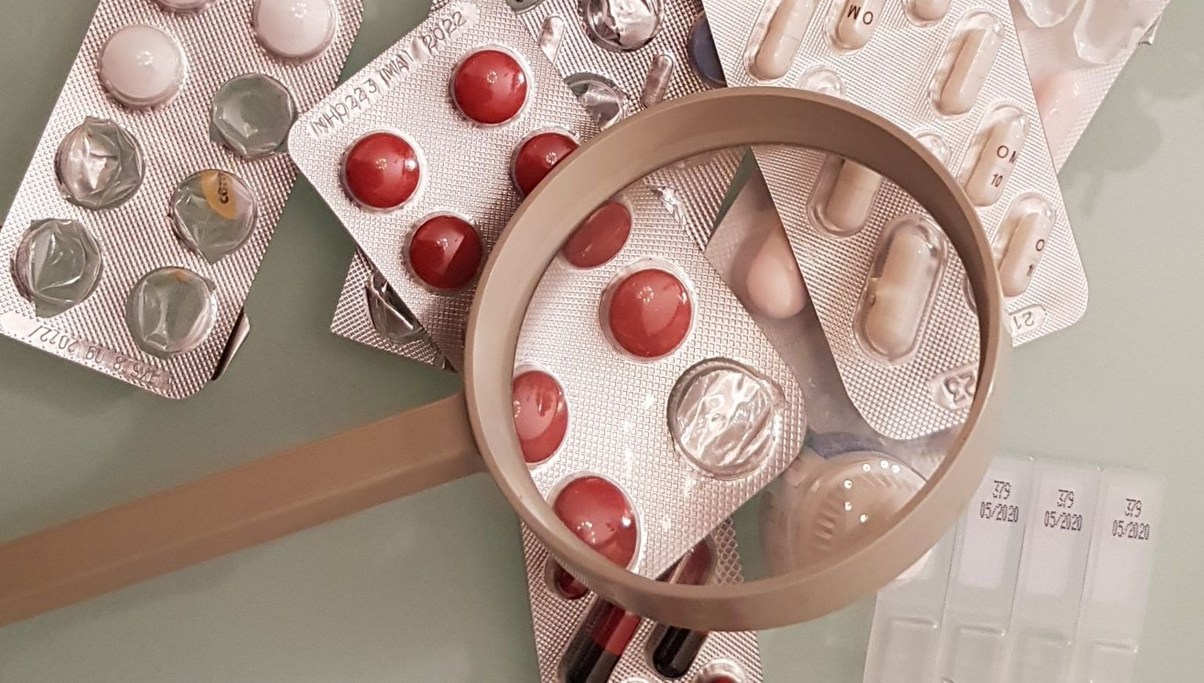

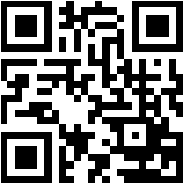
PharmacoVigilance Working Group
Working Group Members
Nicolas Tsiakkas (GRE) – Chairman
Xavier Fournie (FR) – Co-chairman
Zurab Koberidze (DE)
Flemming Kjaer Jorgensen (DK)
Marco Anelli (IT)
EUCROF Secretariat, p/a GroenHoed, Trasmolenlaan 5
3447 GZ Woerden, The Netherlands
www.eucrof.eu | info@eucrof.eu
Notes:
1

Slide 2


Mission
How?
Position EUCROF PV WG as important conduit and as a reference
for stakeholders in the EU pharmacovigilance fora
Cooperation with other EUCROF Working Groups
Pro-active Interaction with Competent Authorities
Scientific Networking
Affiliation with relevant stakeholder groups
Sharing PV expertise within the EUCROF
PV Knowledgebase Build-up and Dissemination
Scope of expertise includes both Post Marketing PV services
(outside a study) and Study Pharmacovigilance services for all types of studies
(Pre/Post Approval ; Clinical Trials and Non-Interventional studies)
Webinar meetings once a month
Yearly Face-to-face meetings
Ad-hoc task forces to address specific subjects
Collaborative writing of papers
Participation in meetings with external stakeholders
Formation of joint task forces with other organisations as required
If you are interested in becoming a member of this working group, please contact:
EUCROF Secretariat - info@eucrof.eu
or
Nicolas Tsiakkas – nicolas.tsiakkas@medwork.gr
Chairman of the Working Group
or
Zurab Koberidze – zurab.koberidze@fgk-pv.com
We are looking for members who are interested in promoting and sharing expertise and developments, aimed at determining and setting overall strategic direction for CROs related to Pharmacovigilance, and liaising with other relevant organizations, to ensure that the work of the group is up to date.
Contact us if you have any suggestions or questions
We are looking forward to hearing from you!
Highlights
Communications in conferences
White papers and other publications
Participation to EMA Public Consultations impacting PV
Involvement in several relevant stakeholder groups
Notes:
2

