Slide 1
xShare
WP5.4 Open Call
EUCROF Team

Slide 2

EHDS regulation
On February 11, 2025, the European Parliament and the Council adopted Regulation (EU) 2025/327, establishing the European Health Data Space (EHDS).
This landmark regulation aims to enhance individuals’ access to and control over their electronic health data, facilitating its use for healthcare delivery, research, innovation, policy-making and more.

Slide 3
xShare contributing to early adoption of EHDS standards
https://xshare-project.eu/
xShare is a three-year Horizon Europe project envisioning everyone sharing their health data in European Electronic Health Record Exchange Format (EEHRxF), with a click-of-a-button.
In 2025, xShare organizes 3 Open Calls for early adoption of EHDS standards, the 3rd one specifically targeting secondary use of health data for the purpose of clinical research. This 3rd call is open to all EUCROF affiliates:
xShare Open Calls 2025
Data Portability under GDPR.
Public Health Dashboards for Decision Makers and health system efficiencies.
EHDS in clinical research

Slide 4
The Open call "EHDS & Clinical Research"
xShare includes a series of actions to facilitate bridging health care (primary use of health data) with public/population health and clinical research (secondary use of health data).
The European Institute for Innovation through Health Data (i-HD), CDISC Europe, HL7 Europe, Telemedicine Technologies S.A.S as well as the European CRO Federation (EUCROF) are involved in this action line.
This includes the development of the IPS+ standard (International Patient Summary with an extension for Research), a proposed new priority health data category under EHDS, the identification and development of business cases and involve the stakeholders to demonstrate the potential through an open call organized by EUCROF. (see appendix 1 with the selected Business Use Cases and attached deliverable D5.2)
In total xShare organizes 3 open calls in different domains all related to the EHDS, see slide 3

Slide 5
Purpose of the Open Call
Practical implementation of business use cases (BUCs) inspired by the identified BUCs demonstrating the benefits of a wide adoption of the EHDS standards (EEHRxF, IPS+) and their impact on European citizens

Slide 6

Who can apply ?
All affiliated members of EUCROF (therefore service providers for clinical research or "CRO"), either alone or in consortium with other stakeholders of clinical research such as hospital sites involved in clinical research or networks of hospital sites or other academic players, patient orgs, private players (pharma, biotechs, medtechs …).
CRO : Contract Research Organization, see definition on the GDPR EUCROF Code of Conduct

Slide 7
Eligibility criteria
The candidate CRO must be affiliated with EUCROF and listed in the public registry of EUCROF GDPR Code of Conduct for Service Providers in Clinical Research (EUCROF GDPR Code or Code).
    More about the Code : https://eucrof.eu/gdpr-code-of-conduct/
    Public Registry : https://cro.eucrof.eu/eucrof-code-public-registry
The proposed demonstration project must fall within the purpose of the open call: see the 10 business cases detailed in the appendix I. The proposal shall clearly identify, which business case(s) the proposal refers (see also the foot note)*
The proposal should include a convincing plan for evaluating how the implementation of the EHDS standards will facilitate future scale-up of the business case.
*Proposals may also refer to other business cases than the ones listed in the appendix and in such a case the proposal shall provide evidence that the BUC fully complies with the purpose (silde 5)

Slide 8
What are the benefits ?
Highly ranked proposals will receive financial support from EUCROF and will be recognized at a special ceremony that will take place in the EUCROF26 Conference
Successful proposals will be:
  offered a complimentary poster and attendance ticket at EUCROF26
  highlighted by means of short videos and interviews
  Presented in social media and web sites (e.g. EUCROF, xShare, EEHRxF Hub)
xShare will work with applicants to support them in the implementation of the EHDS format (EEHRxF) and IPS+
Industry xShare label will be awarded to patient facing products of successful proposals indicating EHDS readiness for your company

Slide 9

How will the applications be assessed ?
An independent committee will be setup by EUCROF in collaboration with xShare consortium leadership the EUCROF26 program committee for the assessment of applications

Slide 10
What are the assessment criteria* ?
The extend to which the underlying BUC corresponds to a "current" demand and business need
The impact for patients (in terms of number of potentially concerned patients, therapeutic options)
The impact for health care professionals (i.e. investigators) involved in clinical research (e.g. productivity, time saving by avoiding double-entry …)
The implementation of the xShare button to enable patients upload/download their IPS-R
The quality of the implementation and its maturity
The replication power across Europe, healthcare facilities, registries, studies
The extend of awareness of the EHDS regulation, Implementation of the EEHRxF format and IPS+
Evidence of adherence with key requirements of the EUCROF Code (DPIA …)
Lessons learned reporting process has been built-in in the process
*To be further elaborated

Slide 11
Assessment criteria
Effectiveness of Business Case Implementation
Higher priority for real-life implementations addressing current demand.
Even if not fully compliant with standards, implementations demonstrating strong potential for future dissemination score higher.
Mockup demonstrators carry less weight due to uncertainty beyond the project's completion.

Slide 12
How to apply
1. Complete the application form
Express your interest in participating by filling in this form.
2. Prepare your outline proposal
Review the present guidelines and ensure your project aligns with the objectives.
3. Submit your application!
Send the outline proposal at xshare@eucrof.eu
For any help and support contact us at xshare@eucrof.eu

Slide 13
“Outline" proposals
Complete the outline proposal form "xShare_EUCROF OpenCall_Outline Proposal_template.docx"
Can also be downloaded from the EUCROF web site

Slide 14
Examples of potential "implementations" (1/2)
Patient Matching Portal for Clinical Studies
A commercial platform connects patients with investigational sites, currently hosting 40,000 registered patients.
A planned feature allows patients to upload IPS+ data for automated study matching instead of manual questionnaires.
Due to the unavailability of real IPS+ data before project completion, mock datasets will be used for testing.
While innovative, this work has no immediate societal impact but holds potential for recognition.

Slide 15
Examples of potential "implementations" (2/2)
Automating Data Transfer for Patient Registries
A high number of hospitals participate in registries, with physicians requesting integration between hospital EHRs and eCRFs to reduce double entries.
A standardized framework has been developed to enable automated data transfer from EHRs to eCRFs.
Initial implementation in 20 hospitals with one registry, ensuring scalability.
In his personal space (ePRO or eConsent), the patient can click the xShare button and download his IPS+
Future adoption of EEHRxF will further streamline the process.
Over 1,000,000 eCRFs potentially impacted.

Slide 16
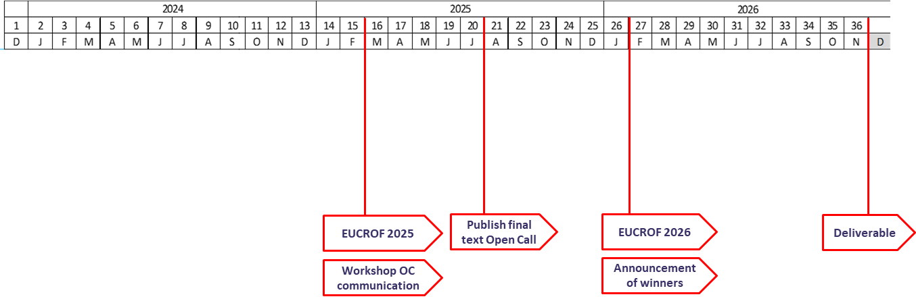
What timelines ?
Outline proposals can be elaborated from now.
The "assessment" report will be produced after the implementation period (year 2026) and be incorporated in the corresponding xShare deliverable

Slide 17
Assessment Committee
Dipak Kalra (xShare WP5 leader)
Yoanni Matsakis (xShare WP5 leader, EUCROF Board)
Catherine Chronaki (xShare scientific leader)
Representative of Academic Sponsors
Representative of Pharma/Biotech
Representative of Investors
Representative of scientific committee of EUCROF26

Slide 18


xShare webinar
WEBINAR 28 May 2025
A webinar focusing on how the European Health Data Space (EHDS), the European Electronic Health Record Exchange Format (EEHRxF) and the xShare Yellow Button are putting citizens / patients in control of their health data.
Webinar Recording

Slide 19
Appendix I – Business Use Cases (all "eligible")
Nb | Description | Scope
1 | Patient pre-screening in clinical trial through a SAREC healthcare professional tool ​ | Prescreening​
2 | Patient self-nomination as possibly eligible for a trial ​(see slide 19) | Prescreening​
3 | Protocol feasibility via a repository of IPS+R summaries, e.g. at hospital, regional or national level ​(see slide 20) | Feasibility​
4 | Targeted patient recruitment via a repository of IPS+R summaries, e.g. at hospital, regional or national level ​ | Prescreening​
5 | Clinical Study support – whole scenario (side effect reporting) ​ | Study support​
6 | Longitudinal cohort tracking ​ | Cohort​
7 | Clinical Study definition ​ | Study support​
8 | Clinical Study follow-ups ​ | Study support​
9 | Site feasibility guided by xShare Button ​ | Feasibility​
10 | eCRF Filling Process - Support for data collection of a health study​ (see slide 21) | Study support​
Business cases in blue are further detailed in the next slides as examples
See detailed use cases in attached document (deliverable D5.2)

Slide 20
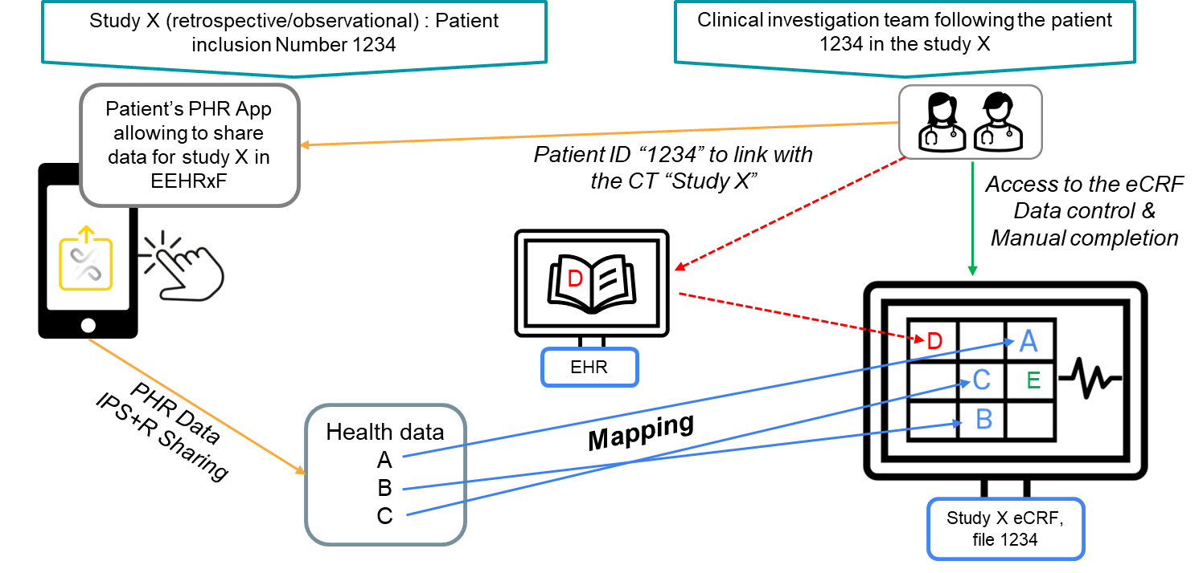

Use cases for IPS+: Study support – PHR/EHRs to EDC flow
/

Slide 21
Appendix I – Business Use Case # 2
(developed ones)
BUC2: Patient self-nomination as possibly eligible for prescreening in a trial thanks to the xShare Button
Context and Goal:
This BUC aims to optimize clinical trial protocol design by allowing pharmaceutical companies to query health data repositories using the EEHRxF format. By assessing eligibility criteria and patient availability across hospitals or regions, this use case helps improve protocol design and trial site selection.
Process
The system enables distributed queries on hospital EHRs to estimate the number of potentially eligible patients based on protocol criteria. This helps determine which hospitals are suitable trial sites.

Slide 22
Appendix I – Business Use Case # 3
(developed ones)
BUC3: Protocol feasibility via a repository of IPS+ summaries (e.g. at hospital, regional or national level)
Context and Goal:
This use case focuses on patient empowerment, allowing individuals to self-nominate for clinical trials. By using the xShare Yellow Button, patients can share their health data and assess their eligibility for trials without needing a healthcare professional to initiate the process.
Process:
Patients can access their health data through a Personal Health Record (PHR) app, share it via the xShare Yellow Button, and check for potential matches with clinical trials. If a trial is a match, they can choose a participating hospital and send their data to initiate the recruitment process.

Slide 23
Appendix I – Business Use Case # 10
(developed ones)
BUC10: Support for data collection of a health study
Context and Goal:
This BUC seeks to automate data collection during clinical trials by integrating patient data from EHRs into the trial’s Case Report Forms (CRFs). This use case uses the xShare Yellow Button to automate and streamline data entry, reducing the manual burden on research teams.
Process:
Once a patient is enrolled in a study and gives consent, their health data (structured in the EEHRxF format) is transferred from the PHR to the CRF. This ensures timely, accurate, and high-quality data input throughout the trial

